Slide 1

Project 18
Estimation of a site where motion of a moving vehicle started using radar data. Extended Kalman filter.
Berman Vladimir, Dronova Maria, Bazhenov Artem

Slide 2
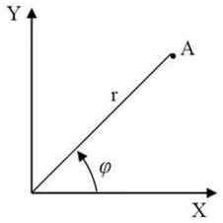

Task
We have three objects, observed by the radar. We have motion data expressed as radius 𝐷 in meters and azimuth 𝛽 in radians. The data is inaccurate, so we also know information about the variance and etc. Our goal is to determine the starting point of the object. To achieve this goal we used Extended Kalman Filter with input of polar system and output with Cartesian system.
$$r=D=\sqrt{x^{2}+y^{2}}$$
$$φ=\frac{π}{2}−β=arctg\left(\frac{x}{y}\right)$$

Slide 3
Relevance
Using this type of filter can be useful for restoring the trajectory of movement of an object, for example, if the plane fell into the water after an accident, when communication with it was lost and its wreckage and black box could not be found. Or to determine the trajectory of the fallen meteorite and etc.

Slide 4

We have nonlinear function $h\left(X_{i}\right)=\left[\begin{matrix}\sqrt{x_{i}^{2}+y_{i}^{2}} \\ arctg\left(\frac{x_{i}}{y_{i}}\right)\end{matrix}\right]$
Only Extended variation of Kalman filter work with them.
$$X_{i+1,i}=Φ_{i+1,i}Χ_{i,i}$$
$$P_{i+1,i}=Ф_{i+1,i}P_{i,i}Ф_{i+1,i}^{Т}+Q^{i}$$

